Slide 1

Pi Day Project
🐍Pi-thon Digits

Slide 2
Pi-thon Digits
Celebrate Pi Day with this ‘Pi’-thon project.
Research π and Pi Day
Grab your CodeX
And write some code!

Slide 3
Pi-thon Digits
Start with some research. You will need to add some information to this project.
Find the value of π to at least 100 digits.
Find some interesting facts about π.
Save this information in a Google doc, notepad file, or similar document to use in your project.

Slide 4
Pi-thon Digits
Time to code!
Grab your CodeX.
Log in to make.firialabs.com and go to the Sandbox.
Start a new file: pi_thon_day

Slide 5
Pi-thon Digits
Starter Code
Some of the code for this project is provided for you.
Open the starter code text file for this project.
  pi_thon_starter_code
Copy and paste the code into your new project file.

Slide 6
Pi-thon Digits
Starter Code
Run the code to make sure you don’t have any errors.
You should see a menu.
When BTN-A is pressed, the program should stop.
Everything good? Great! Ready to continue…

Slide 7
Pi-thon Digits
Step 1: Pi digits and facts
A variable for pi is defined near the top of the program.
Change the value of pi to include at least 100 digits.
You found this information earlier, and saved it in a file.
Copy and paste, or type, 100 or more digits of pi.

Slide 8
Pi-thon Digits
Step 1: Pi digits and facts
A list of pi facts is defined near the top of the program.
You found more pi facts earlier, and saved them in a file.
Copy and paste, or type, more pi facts into pi_facts.
  Each fact needs to be enclosed in quotation marks.
  Separate each fact with a comma.

Slide 9
Pi-thon Digits
Step 2: Show the digits
Add some code to display a ‘pi’-thon snake of pi digits scrolling across the screen at a random location.

Slide 10
Pi-thon Digits
Step 2: Show the digits
Start with a new while True: loop, below the one already there.
Define the variables you need for scrolling digits.
  delay (for the speed of the scrolling); adjust the value of delay for the speed you want.
  index (to traverse the list of digits)
  pi_y (random row on the screen for the digits)

Slide 11
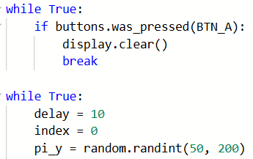
Pi-thon Digits

Slide 12
Pi-thon Digits
Step 2: Show the digits
Start another while True: loop, inside the loop.
Display the digits in the loop.
  Display the value of pi
  Short delay
  Clear the screen
  Increment index

Slide 13
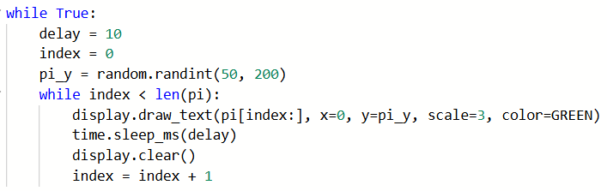
Pi-thon Digits

Slide 14
Pi-thon Digits
Step 2: Show the digits
Run the program.
You should see a long stream of pi digits.
Then, after the stream ends, a new stream starts in a new random location.

Slide 15
Pi-thon Digits
Step 3: Stop the program
The program goes on continuously, because the loop is always True.
The menu indicates BTN-D should stop the program.
Add an if statement for BTN-D that clears the screen and breaks the loop.

Slide 16
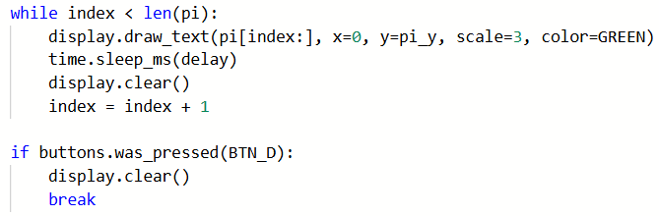
Pi-thon Digits

Slide 17
Pi-thon Digits
Step 3: Stop the program
Run the program.
Press BTN-D.
When the stream of digits ends, the program will stop.

Slide 18
Pi-thon Digits
Step 4: Pi facts
The menu indicates BTN-B should show a pi fact.
You want to stop the stream anytime the button is pressed and show a fact, so this will take a couple steps.
First, define a Boolean variable to indicate if a fact is to be shown.

Slide 19
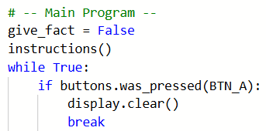
Pi-thon Digits

Slide 20
Pi-thon Digits
Step 4: Pi facts
Now add an if statement to the loop that displays the digits.
If BTN-B is pressed, the value of the Boolean give_facts is updated to True and the loop breaks.

Slide 21
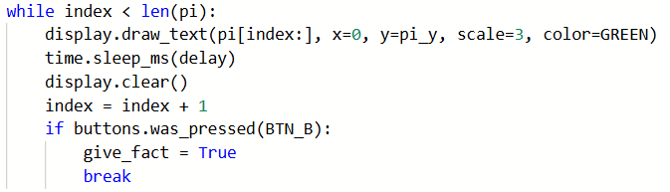
Pi-thon Digits

Slide 22
Pi-thon Digits
Step 4: Pi facts
Run the program.
Press BTN-B.
A new random stream will start. This shows that the if statement is working.
But we want random facts. So … keep coding!

Slide 23
Pi-thon Digits
Step 4: Pi facts
Add an if statement that uses the Boolean give_facts.
If give_facts is True
  Update the give_facts to False
  Display a random fact
  Wait for a button press to continue
  Be very careful with indenting!

Slide 24
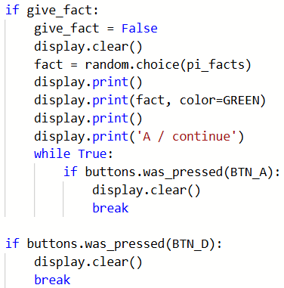
Pi-thon Digits

Slide 25
Pi-thon Digits
Step 4: Pi facts
Run the program.
Press BTN-B.
A pi fact will appear and wait for a button press.
Almost done!

Slide 26
Pi-thon Digits
Step 5: Pi-thon snake
You have a pi digits and pi facts program.
But you may have noticed that the starter code includes a snake head.
Modify the program so the stream of digits looks like a ‘pi’-thon by adding the snake head at the beginning of the stream of digits.

Slide 27
Pi-thon Digits
Step 5: Pi-thon snake
This is going to take a little bit of math to make it look realistic.
Start with two more variables:
  snake_x for the starting position of the snake head
  pi_x for the starting position of the digits stream
  The initial values of the variables are based on the size of the snake head

Slide 28
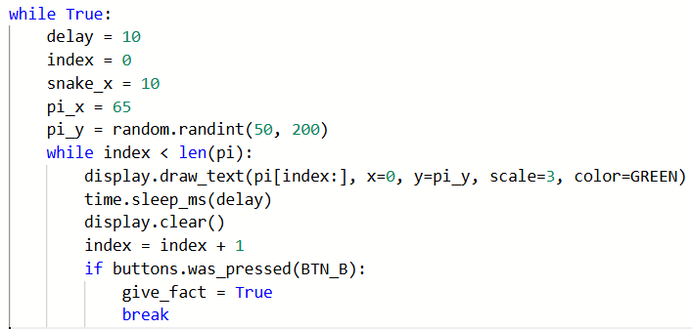
Pi-thon Digits

Slide 29
Pi-thon Digits
Step 5: Pi-thon snake
Create another while loop for the snake head.
This will be the first loop inside the infinite loop.
It will call the snake head and then the pi digits.
Decrease the values of snake_x and pi_x to move to the left.
Increase index to stream the digits.
Stop the loop when the head reaches the edge of the screen.

Slide 30
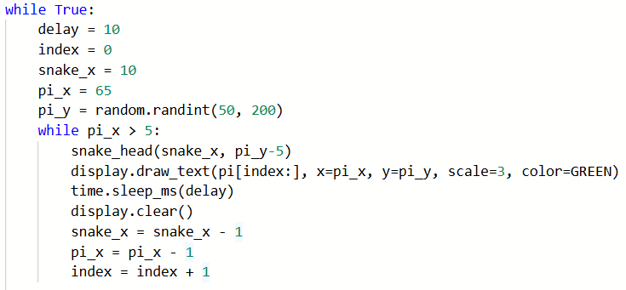
Pi-thon Digits

Slide 31
Pi-thon Digits
Happy ‘Pi’-thon Day!
Run the program.
Press BTN-B to see a pi fact.
Press BTN-D to stop the code.
Enjoy the pi-thon, streaming digits and pi facts.
And, maybe, even have a piece of pi.

